Slide 1

CSE488: Big Data Analytics
Lecture 10: Clustering
Dr. Mohammad Rezwanul Huq
Associate Professor
East West University

Slide 2
Hierarchical /Agglomerative and Point- Assignment Approaches
Measures of “Goodness” for Clusters
BFR Algorithm
CURE Algorithm
Clustering

Slide 3
The Problem of Clustering
Given a set of points, with a notion of distance between points, group the points into some number of clusters, so that members of a cluster are “close” to each other, while members of different clusters are “far.”

Slide 4
Example: Clusters
x
xx x
x x
x x x
x
x x x
x
x
x x
x x x x
x x x x
x x x
x x
x x
x x x x
x x x
x
x

Slide 5
Problems With Clustering
Clustering in two dimensions looks easy.
Clustering small amounts of data looks easy.
And in most cases, looks are not deceiving.

Slide 6
The Curse of Dimensionality
Many applications involve not 2, but 10 or 10,000 dimensions.
  Example: clustering documents by the vector of word counts (one dimension for each word).
High-dimensional spaces look different: almost all pairs of points are at about the same distance.

Slide 7
Example: Curse of Dimensionality
Assume random points between 0 and 1 in each dimension.
In 2 dimensions: a variety of distances between 0 and 1.41.
In any number of dimensions, the distance between two random points in any one dimension is distributed as a triangle.
Half the points are the first
of points at distance ½.
Any point is distance
zero from itself.
Only points 0 and
1 are distance 1.

Slide 8
Example – Continued
The distance between two random points in n dimensions, with each dimension distributed as a triangle, becomes normally distributed as n gets large.
And the standard deviation grows as the square root of the average distance.
  I.e., “all points are the same distance apart.”

Slide 9
Euclidean and Non-Euclidean Distances
Euclidean spaces have dimensions, and points have coordinates in each dimension.
Distance between points is usually the square-root of the sum of the squares of the distances in each dimension.
Non-Euclidean spaces have a distance measure, but points do not really have a position in the space.
  Big problem: cannot “average” points.

Slide 10
Example: DNA Sequences
Objects are sequences of {C,A,T,G}.
Distance between sequences = edit distance = the minimum number of inserts and deletes needed to turn one into the other.
  Notice: no way to “average” two strings.
  Question for thought: why not make half the changes and call that the “average”?
In practice, the distance for DNA sequences is more complicated: allows other operations like mutations (change of a symbol into another) or reversal of substrings.

Slide 11
Methods of Clustering
Hierarchical (Agglomerative):
  Initially, each point in cluster by itself.
  Repeatedly combine the two “nearest” clusters into one.
Point Assignment:
  Maintain a set of clusters.
  Place points into their nearest cluster.
  Possibly split clusters or combine clusters as we go.

Slide 12
Which is Better?
Point assignment good when clusters are nice, convex shapes.
Hierarchical can win when shapes are weird.
  Note both clusters have essentially the same centroid.
Aside: if you realized you had concentric
clusters, you could map points based on
distance from center, and turn the problem
into a simple, one-dimensional case.

Slide 13
Hierarchical Clustering
Two important questions:
  How do you determine the “nearness” of clusters?
  How do you represent a cluster of more than one point?

Slide 14
Locating Clusters
Euclidean case: each cluster has a centroid = average of its points.
  Represent cluster by centroid + count of points.
  Measure intercluster distances by distances of centroids.
    That is only one of several options.

Slide 15
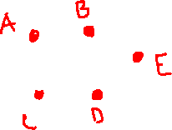
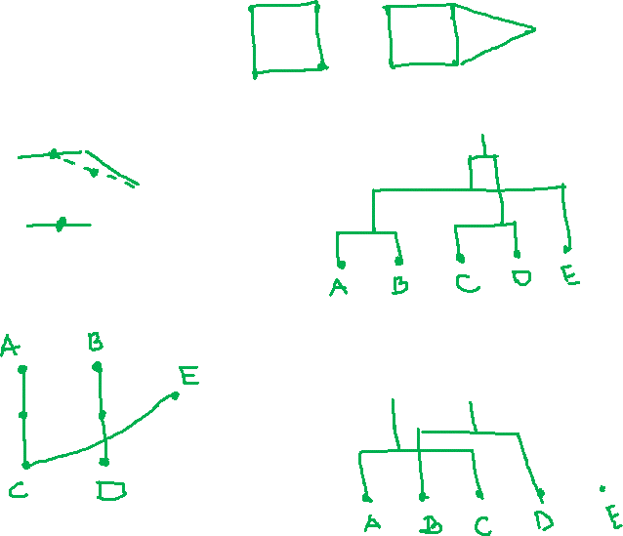

Slide 16
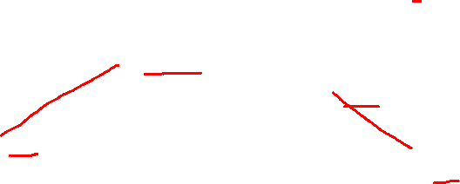
Example
(5,3)
o
(1,2)
o
o (2,1) o (4,1)
o (0,0) o
(5,0)
x (1.5,1.5)
x (4.7,1.3)
x (1,1)
x (4.5,0.5)

Slide 17
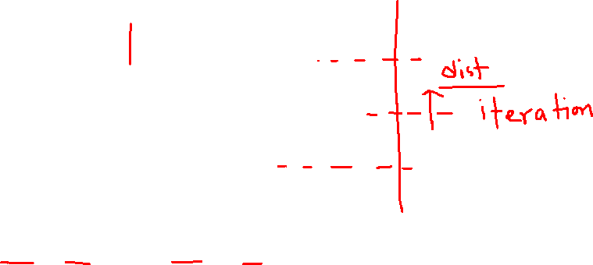
Dendrogram
(0,0)
(1,2)
(2,1)
(4,1)
(5,0)
(5,3)

Slide 18
And in the Non-Euclidean Case?
The only “locations” we can talk about are the points themselves.
  I.e., there is no “average” of two points.
Approach 1: clustroid = point “closest” to other points.
  Treat clustroid as if it were centroid, when computing intercluster distances.

Slide 19
“Closest” Point?
Possible meanings:
  Smallest maximum distance to the other points.
  Smallest average distance to other points.
  Smallest sum of squares of distances to other points.
  Etc., etc.

Slide 20
Example: Intercluster Distance
clustroid
1
2
6
4
3
5
clustroid
intercluster
distance

Slide 21
Other Approaches to Defining “Nearness” of Clusters
Approach 2: intercluster distance = minimum of the distances between any two points, one from each cluster.
Approach 3: Pick a notion of “cohesion” of clusters, e.g., maximum distance from the centroid or clustroid.
  Merge clusters whose union is most cohesive.

Slide 22
Cohesion
Approach 1: Use the diameter of the merged cluster = maximum distance between points in the cluster.
Approach 2: Use the average distance between points in the cluster.

Slide 23
Cohesion – (2)
Approach 3: Density-based approach: take the diameter or average distance, e.g., and divide by the number of points in the cluster.
  Perhaps raise the number of points to a power first, e.g., square-root.

Slide 24
Which is Best?
It really depends on the shape of clusters.
  Which you may not know in advance.
Example: we’ll compare two approaches:
  Merge clusters with smallest distance between centroids (or clustroids for non-Euclidean).
  Merge clusters with the smallest distance between two points, one from each cluster.

Slide 25
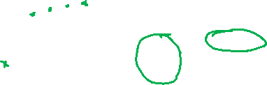
Case 1: Convex Clusters
Centroid-based merging works well.
But merger based on closest members might accidentally merge incorrectly.
C
A
B
A and B have closer centroids
than A and C, but closest points
are from A and C.

Slide 26
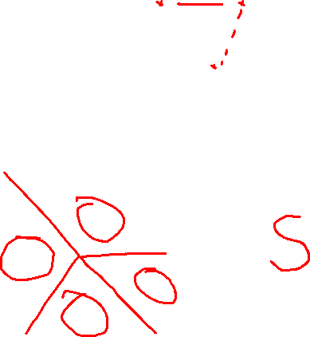
Case 2: Concentric Clusters
Linking based on closest members works well.
But Centroid-based linking might cause errors.

Slide 27
k–Means Algorithm(s)
An example of point-assignment.
Assumes Euclidean space.
Start by picking k, the number of clusters.
Initialize clusters with a seed (= one point per cluster).
  Example: pick one point at random, then k-1 other points, each as far away as possible from the previous points.
    OK, as long as there are no outliers (points that are far from any reasonable cluster).

Slide 28
k-Means++
Basic idea: pick a small sample of points, cluster them by any algorithm, and use the centroids as a seed.
In k-means++, sample size = k times a factor that is logarithmic in the total number of points.
How to pick sample points: Visit points in random order, but the probability of adding a point p to the sample is proportional to D(p)².
  D(p) = distance between p and the nearest picked point.

Slide 29
k-Means | |
k-means++, like other seed methods, is sequential.
  You need to update D(p) for each unpicked p due to new point.
Parallel approach: compute nodes can each handle a small set of points.
  Each picks a few new sample points using same D(p).
Really important and common trick: don’t update after every selection; rather make many selections at one round.
  Suboptimal picks don’t really matter.

Slide 30
Populating Clusters
For each point, place it in the cluster whose current centroid it is nearest.
After all points are assigned, fix the centroids of the k clusters.
Optional: reassign all points to their closest centroid.
  Sometimes moves points between clusters.
  You could then iterate, since new clusters have new centroids, which could change the assignment of some points.

Slide 31
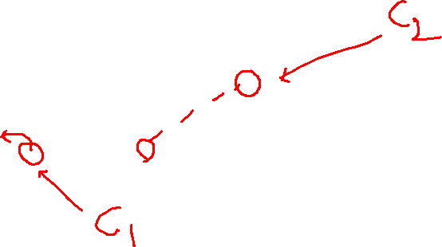
Example: Assigning Clusters
Reassigned
points
2
4
x
6
7
5
x
3
1
8
Clusters after first round

Slide 32
Getting k Right
Try different k, looking at the change in the average distance to centroid, as k increases.
Average falls rapidly until right k, then changes little.
Note: binary search
for k is possible.
Average
distance to
centroid
Best value
of k
k

Slide 33
Example: Picking k
x
xx x
x x
x x x
x
x x x
x
Too few clusters;
many long
distances
to centroid.
x
x x
x x x x
x x x x
x x x
x x
x x
x x x x
x x x
x
x

Slide 34
Example: Picking k
x
xx x
x x
x x x
x
x x x
x
x
Just right;
distances
rather short.
x x
x x x x
x x x x
x x x
x x
x x
x x x x
x x x
x
x

Slide 35
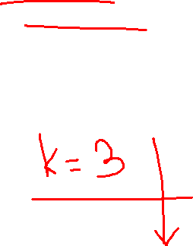
Example: Picking k
Too many clusters;
little improvement
in average distance.
x
xx x
x x
x x x
x
x x x
x
x
x x
x x x x
x x x x
x x x
x x
x x
x x x x
x x x
x
x

Slide 36
BFR Algorithm
BFR (Bradley-Fayyad-Reina) is a variant of k-means designed to handle very large (disk-resident) data sets.
It assumes that clusters are normally distributed around a centroid in a Euclidean space.
  Standard deviations in different dimensions may be different.
    E.g., cigar-shaped clusters.
Goal is to find cluster centroids; point assignment can be done in a second pass through the data.

Slide 37
BFR – (2)
Points are read one main-memory-full at a time.
Most points from previous memory loads are summarized by simple statistics.
  Also kept in main memory, which limits how many points can be read in one “memory full.”
To begin, from the initial load we select the initial k centroids by some sensible approach.

Slide 38
Three Classes of Points
The discard set (DS): points close enough to a centroid to be summarized.
The compression set (CS): groups of points that are close together but not close to any centroid. They are summarized, but not assigned to a cluster.
The retained set (RS): isolated points.

Slide 39
“Galaxies” Picture
Points in RS
Compression sets.
Their points are in CS.
A cluster. Its points
are in DS.
The centroid

Slide 40
Summarizing Sets of Points
Each cluster in the discard set and each compression set is summarized by:
  The number of points, N.
  The vector SUM, whose i ^{th} component is the sum of the coordinates of the points in the i ^{th} dimension.
  The vector SUMSQ: i ^{th} component = sum of squares of coordinates in i ^{th} dimension.

Slide 41
Comments
2d + 1 values represent any number of points.
  d = number of dimensions.
Averages in each dimension (centroid coordinates) can be calculated easily as SUM_{i}/N.
  SUM_{i} = i ^{th} component of SUM.
Variance in dimension i can be computed by: (SUMSQ_{i} /N ) – (SUM_{i} /N )²
  And the standard deviation is the square root of that.

Slide 42
Processing a “Memory-Full” of Points
Find those points that are “sufficiently close” to a cluster centroid; add those points to that cluster and the DS.
Use any main-memory clustering algorithm to cluster the remaining points and the old RS.
  Clusters go to the CS; outlying points to the RS.
    These are not “clusters” in the sense of being one of the k clusters of the final answer.

Slide 43
Processing – (2)
Adjust statistics of the clusters to account for the new points.
  Consider merging compressed sets in the CS.
If this is the last round, merge all compressed sets in the CS and all RS points into their nearest cluster.

Slide 44
A Few Details . . .
How do we decide if a point is “close enough” to a cluster that we will add the point to that cluster?
How do we decide whether two compressed sets deserve to be combined into one?

Slide 45
How Close is Close Enough?
We need a way to decide whether to put a new point into a cluster.
BFR suggest two ways:
  The Mahalanobis distance is less than a threshold.
  Low likelihood of the currently nearest centroid changing.

Slide 46
Mahalanobis Distance
Normalized Euclidean distance from centroid.
For point (x₁,…, x_{d}) and centroid (c₁,…, c_{d}):
  Normalize in each dimension: y_{i} = (x_{i} -c_{i})/σ_{i}
    σ_{i} = standard deviation in i ^{th} dimension for this cluster.
  Take sum of the squares of the y_{i} ’s.
  Take the square root.

Slide 47
Mahalanobis Distance – (2)
If clusters are normally distributed in d dimensions, then after transformation, one standard deviation = √d.
  I.e., 70% of the points of the cluster will have a Mahalanobis distance < √d.
Accept a point for a cluster if its M.D. is < some threshold, e.g. 4 standard deviations.

Slide 48
Picture: Equal M.D. Regions
2σ
σ

Slide 49
Should Two CS Subclusters Be Combined?
Similar to measuring cohesion. For example:
Compute the variance of the combined subcluster, in each dimension.
  N, SUM, and SUMSQ allow us to make that calculation quickly.
Combine if the sum of the variances is below some threshold.
Many alternatives: treat dimensions differently, consider density.

Slide 50
The CURE Algorithm
Problem with BFR/k-means:
  Assumes clusters are normally distributed in each dimension.
  And axes are fixed – ellipses at an angle are not OK.
CURE:
  Assumes a Euclidean distance.
  Allows clusters to assume any shape.

Slide 51
Example: Stanford Faculty Salaries
h
h
h
e
e
e
h
e
e
e
h
e
e
e
e
h
salary
e
h
h
h
h
h
h
h
age

Slide 52
Starting CURE
Pick a random sample of points that fit in main memory.
Cluster these points hierarchically.
For each cluster, pick a sample of points, as dispersed as possible.
Pick representatives for the cluster by moving the sample points (say) 20% toward the centroid of the cluster.

Slide 53
Example: Initial Clusters
h
h
h
e
e
e
h
e
e
e
h
e
e
e
e
h
salary
e
h
h
h
h
h
h
h
age

Slide 54
Example: Pick Dispersed Points
h
h
h
e
e
e
h
e
e
e
h
e
e
e
e
h
salary
e
Pick (say) 4
remote points
for each
cluster.
h
h
h
h
h
h
h
age

Slide 55
Example: Pick Dispersed Points
h
h
h
e
e
e
h
e
e
e
h
e
e
e
e
h
salary
e
Move points
(say) 20%
toward the
centroid.
h
h
h
h
h
h
h
age

Slide 56
Why the 20% Move Inward?
A large, dispersed cluster will have large moves from its boundary.
A small, dense cluster will have little move.
Favors a small, dense cluster that is near a larger dispersed cluster.

Slide 57
Finishing CURE
Now, visit each point p in the data set.
Place it in the “closest cluster.”
  CURE definition of “closest”: that cluster with the closest (to p) among all the representative points of all the clusters.

